Slide 1



Out of the Fog and into the Cloud
Memorial University’s Cloud Computing Investigation
June 7, 2011
Notes:
#1 in Canada for most fog per year
#2 in Canada for cloud cover (close second to Price Rupert)

Slide 2
Objectives
Describe the “Cloud”
What the cloud means for Higher Education
Discuss Memorial’s Identified Cloud Opportunities
Detail Memorial’s Google Apps for Education Pilot
Discuss our next steps
Notes:
Albert

Slide 3
What is Cloud Computing?
“on-demand network access to a shared pool of configurable computing resources (e.g., networks, servers, storage, applications, and services) that can be rapidly provisioned and released with minimal management effort or service provider interaction”
US National Institute of Standards and Technology (NIST)
Notes:
Ash
A shift to Information Technologies as utility-like services
5 Essential Characteristics
On-demand self-service
Broad network access
Resource pooling
Rapid elasticity
Measured Service
3 Service Models
Cloud Software as a Service (SaaS)
Cloud Platform as a Service (PaaS)
Cloud Infrastructure as a Service (IaaS)
4 Deployment Models
Private cloud
Community cloud
Public cloud
Hybrid cloud

Slide 4
What does this mean for education?
Memorial’s Cloud Investigation
Notes:
Albert

Slide 5

Major Players in the Higher Education Cloud
Notes:
Albert
Apple’s ITunes U now has 800 Universities with over 300 million downloads
IBM and Microsoft recently announced plans to offer free resources to individual researchers and institutions

Slide 6
Rationale
There are compelling strategic benefits
To explore and highlight opportunities
To recommend an initial starting place to embrace the cloud
To develop new core competencies and move away from non-strategic competencies
Explore services to improve and better suit the needs of stakeholders
Notes:
Albert

Slide 7
Process
May 2010
Formation of Group
June – August 2010
Collaboration on Requirements and refinement
June 2010
Focus Group Session
September 2010
Presentation to IMC
Notes:
Ash

Slide 8
Opportunities and Benefits
A modern, competitive environment
Ability to redistribute resources
Improved service
Increased stability
Less risk re. security and privacy?
Notes:
Ash
Better service: Email, upwards of 10 gb storage, office and collaboration for free
Flexibility: use and pay for what you need, increase resources as you need them
Greater mobility: Resources designed for virtually any computing or mobile device
Allows: Staff could be free to concentrate on other pertinent issues and innovative projects.

Slide 9
Risks and Challenges
Security / Privacy
Ownership of data
E-discovery
Bandwidth Usage
Changes to the Cloud Model
Liabilities
Notes:
Albert
Privacy:
-Contracts and agreements, consultation with departments and expertise, ongoing communications and education plans
Ownership: Laws in place to protect, may be misconceptions about how private a service really is.
E-discovery – concerns physical access (or lack of) for examination of incidents, etc.
-

Slide 10
Opportunities for Memorial
Email
DNS
Centralized Authentication
Backups / Recovery
Cost
Spam / Anti-Virus
Seasonal Applications
Risk
Personal Webpages
Databases
Rationale
Streaming Video
Web Hosting
Notes:
Ash

Slide 11
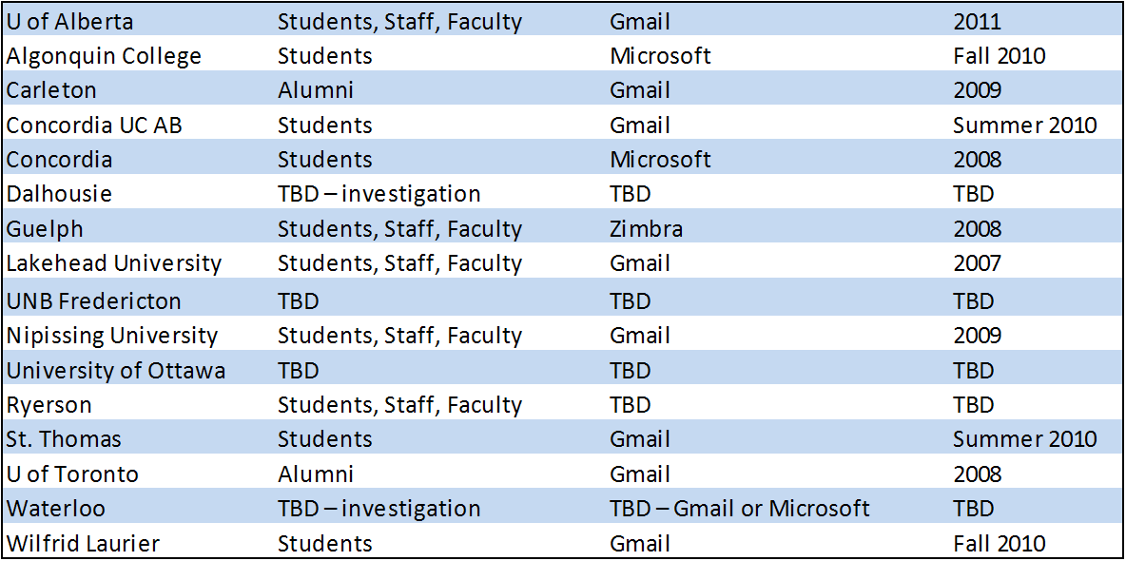
Canadian Institutions Using or Considering Cloud Email
Source: Canadian Schools using or considering Cloud Email Carleton University
Notes:
Albert

Slide 12
Service Provider Decision
We evaluated both Microsoft’s Live@edu and Google apps for education
Neither Google or Microsoft offered clear advantages
Through assessment some functionality difference
The C&C “Cloud” team made a justified recommendation of Google in December 2010
Notes:
Ash
*Recommendation was made to Memorial’s Information Management Committee

Slide 13
Purpose of the Pilot
To gather student feedback on experience
Do sufficient benefits exist?
Are there technical and support impacts?
Are there any new risks?
Develop a recommendation and plan for a broader based implementation
Notes:
Albert

Slide 14

Leading up to the Pilot
Support
Legal
Communication
Technical
Privacy
Notes:
Albert – Legal, Privacy, Communication
Ash – Support, Technical

Slide 15
Memorial’s Pilot
Homogeneous group of collaborating students
Term 4 students in the Business Co-op program
Spring Semester (May to Aug, 2011)
159 students in the initial group – 1 opted out and several new students are eligible
Notes:
Albert
Students may opt-out of the pilot with full understanding of the fact their data may be stored in the U.S.

Slide 16
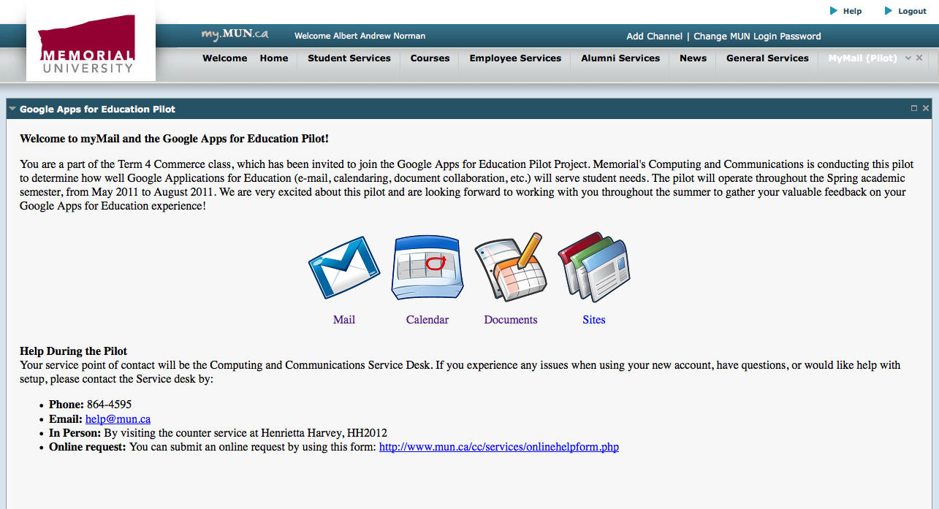
Portal Channel
Notes:
Albert

Slide 17
Memorial’s Pilot
 | Google Apps | Student mail
Quota | > 7.5 GB | 200 – 400 MB
Calendar | Yes | No
Document Creation/Collaboration | Yes | No
Messaging / Video chat | Yes | No
Protocols | IMAP, Google Sync, Outlook Connector | IMAP
Webmail | Modern, Full featured | Antiquated
Personal / Group Websites | Yes | Limited
Notes:
Albert

Slide 18
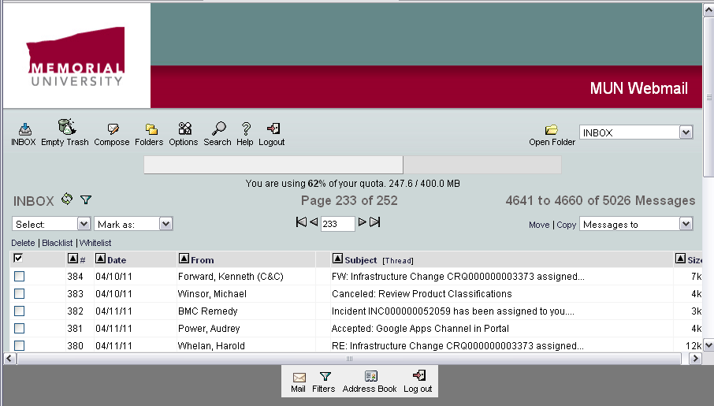
Memorial Webmail
Notes:
Albert

Slide 19
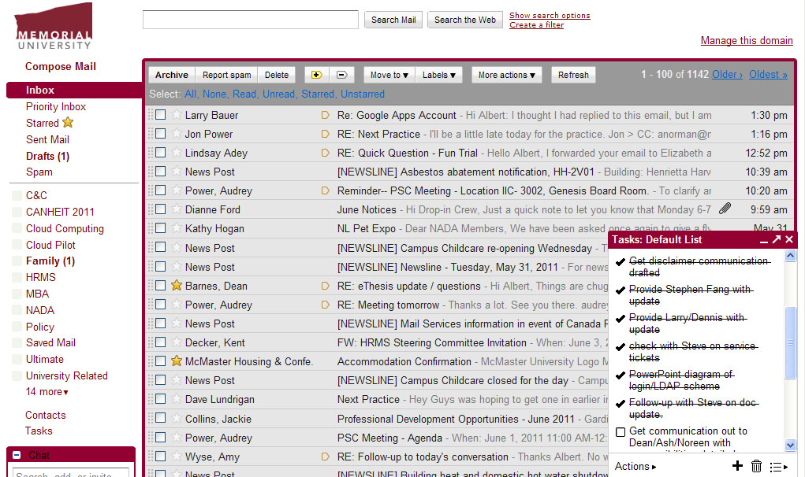
Google Apps
Notes:
Albert

Slide 20
Results – May 2nd to Present
Minor conversion glitches
  Access issues
  Setting up mobile devices (iPhones, Blackberrys etc.)
“Pilot looks great! So far everyone seems to be enjoying the switch, and I've heard only good things : )”
Notes:
Ash

Slide 21
Methods of Measurement
A comprehensive survey, delivered to participating students at the end of the pilot
Focus group session(s) with pilot participants
Assessment of technical integration
Service desk statistics
Notes:
Albert

Slide 22
Additional Areas of Investigation
Analyze Privacy and Security Issues
Agreement and Contract Language
University Policy
Analyze peer outsourcing models and experience
Notes:
Albert

Slide 23

Technical Design
Mail Routing
Mail Protocols
Authentication Options
Integration with LDAP
Notes:
Ash
There are a couple of ways to route mail when using Google Apps for Education. The first two are classified as Dual Delivery in Google’s documentation.
Send all your mail to your on premise mail servers, and direct mail for google to google.
Send all of your mail to google and send anything that doesn’t match back to your on-premise mail servers.
If Google is your only mail server, send all your mail to google.

Slide 24
Technical Design
Google
Internet
Outbound
MX
ListServ
Horde
Webmail
Cyrus
Desktop
Clients
Inbound
MX
Exchange
Other Mobile
Devices
OWA
External
Affiliated Mail
Systems
BES
Blackberry
Memorial Mail Systems
Gmail
Notes:
Spam Filtering at Inbound MX

Slide 25

Technical Design
Google
Internet
Outbound
MX
ListServ
Horde
Webmail
Cyrus
Desktop
Clients
Inbound
MX
Exchange
Other Mobile
Devices
OWA
External
Affiliated Mail
Systems
BES
Blackberry
Mail Routing to Google
Gmail
Notes:
Spam Filtering at Inbound MX

Slide 26
Technical Design
Google
Internet
Outbound
MX
ListServ
Horde
Webmail
Cyrus
Desktop
Clients
Inbound
MX
Exchange
Other Mobile
Devices
OWA
External
Affiliated Mail
Systems
BES
Blackberry
Mail Routing from Google
Gmail
Notes:
Spam Filtering at Inbound MX

Slide 27








Authentication
Mobile Device
Authenticates against stored
(Encrypted SHA1) credentials
Browser
MUN Portal/MUN Login
Single sign-on through
SAML Authentication
LDAP
Password Change
Synchronization of new password (encrypted) with Google

Slide 28
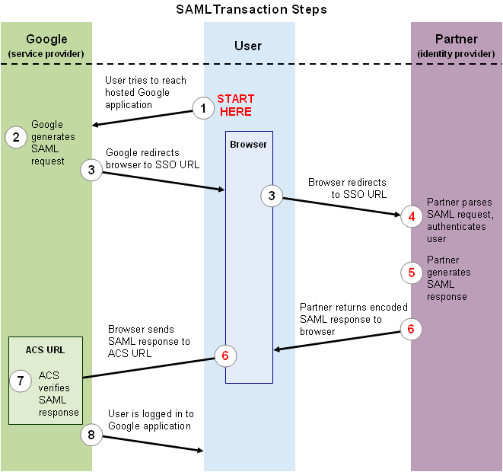
Authentication

Slide 29

In Conclusion
Analysis of findings
Present a Pilot assessment report with recommendation to the IMC
Development of a plan for broader roll-out
We do believe that the Cloud will play an important role in the technology future of Memorial
Notes:
Albert

Slide 30

Albert Norman
anorman@mun.ca
Ash Stirling
ashley@mun.ca

